Slide 1
Amazon Co-Purchasing Ground-Truth Communities
Kanika Mohpal
Sushaanth Srirangapathi
Vijitha Vasantha Kumar
Yi Zheng

Slide 2
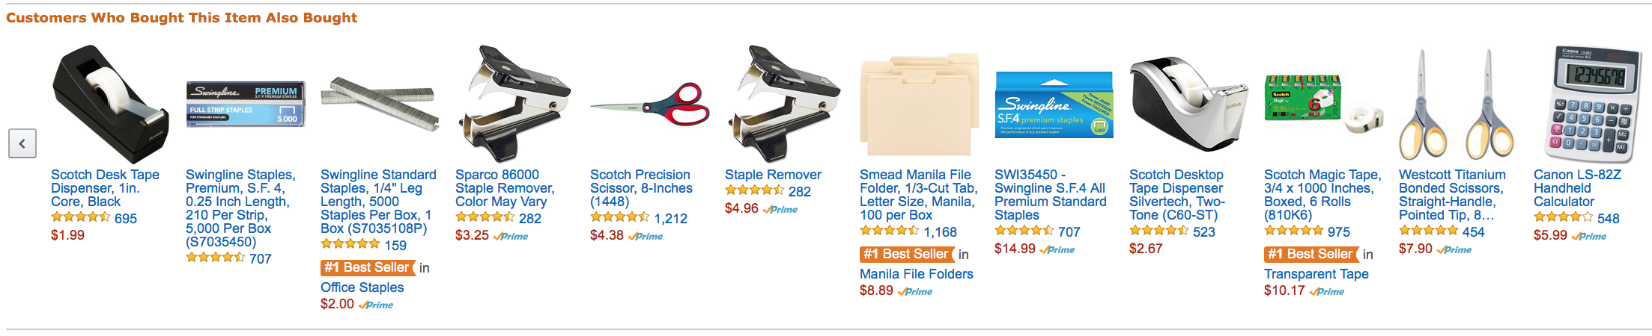
Background
It is based on Customers Who Bought This Item Also Bought (frequent itemsets) feature of the Amazon website.
If a product i is frequently co-purchased with product j in multiple transactions, the graph contains an edge from i to j.

Slide 3
Motivation
Understanding concept behind social network evolution and techniques to analyse networks formed through social behavior
Application of varied concepts of social network analysis on real world social networks to gain insights and appreciate the importance of such analysis from a business and research perspective
Stress on importance of understanding network analysis which can provide greater insights with less information about the features of the nodes
Proof of concept that network analysis techniques used to derive insights from social networks is similar to most business domains affected by social behavior.

Slide 4
Objective
Identification of frequent item-set neighborhood
Selection of products amenable to promotional offers
Choosing items having common features as candidates for recommendation
Usage of frequent item-set communities to aid in catalog design

Slide 5
Data Description
This dataset in consideration is part of work done by J. Yang and J. Leskovec[1] and sourced from SNAP dataset by Stanford
Network data was collected by crawling the Amazon website based on “Customers Who Bought This Item Also Bought” feature
If a product i is frequently co-purchased with product j more than a certain number of times, the graph contains an undirected edge from i to j
Product categories are not explicitly given in the dataset
The 3 source dataset files
Edge list of frequent item pairs
Ground truth communities identified
Top 5000 communities from [1]

Slide 6
Amazon Dataset Statistics
Property | Value
Nodes | 334863
Edges | 925872
Nodes in largest WCC | 334863 (1 component)
Edges in largest WCC | 925872
Nodes in largest SCC | 334863 (1 component)
Edges in largest SCC | 925872
Average clustering coefficient | 0.3967
Number of triangles | 667129
Fraction of closed triangles | 0.07925
Diameter (longest shortest path) | 44

Slide 7
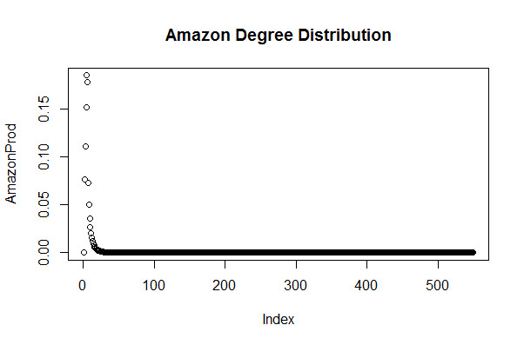
Network Formation
The alpha value 0.11 at equilibrium shows Preferential Attachment of the Amazon dataset

Slide 8
Process Flow
2-phase algorithm approach to derive communities
Greedy Community Detection on Original Network
Edge Betweenness Community Detection on a large community
Rank and analyze the resulting communities on “goodness” measures
Analysis of Similarity/Transaction trends
Evaluate against top 5000[1] ground truth communities

Slide 9
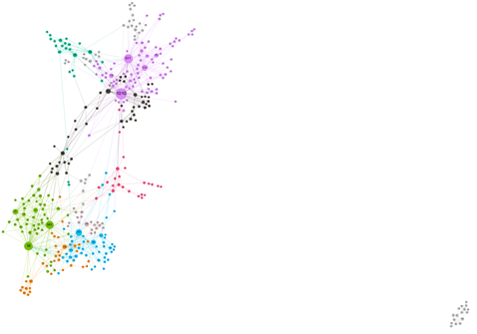
Measures of Community Goodness
The size of the vertex is based on the degree of the node
The colors are based on modularity
Figure: A subgraph of the network

Slide 10
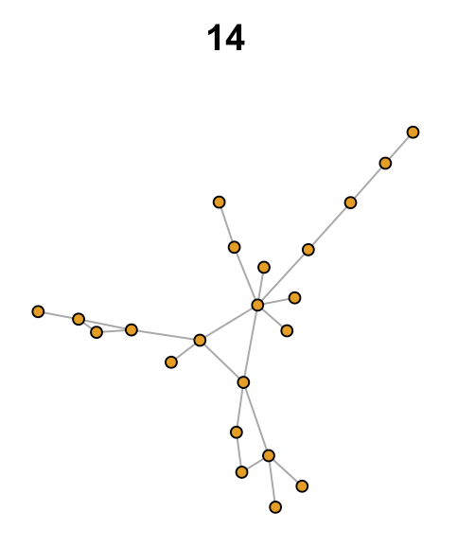
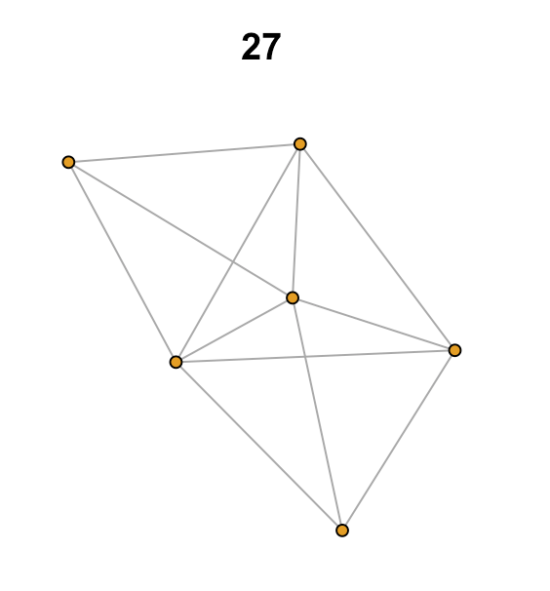
Ranking Communities
Goodness Measure
Transitivity/Clustering coeff | 0.1154 | 0.7894
Density | 0.1039 | 0.8000
Average Path Length | 3.45 | 1.20
Diameter | 8 | 2
Modularity | 0.864 | 0.864
Score | 7.498 | 8.502

Slide 11
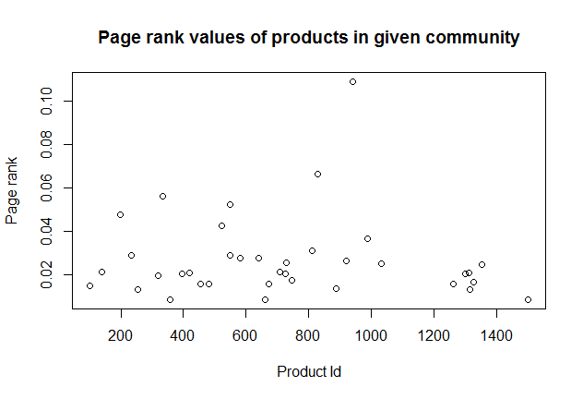
Product scoring for content based communities
When the user selects an item:
Identify the communities it is a part of
Select the best community using the goodness score
Within the community, use pagerank of the items to recommend a list of products having relevant importance

Slide 12
Applications
Target Marketing
Provide offers and promotions
Content based product recommendations
Segmentation
Identify different market segments
Positioning
Improve competitive position, by improving sales

Slide 13
Citation
[1] J. Yang and J. Leskovec. Defining and Evaluating Network Communities based on Ground-truth. ICDM, 2012.
[2] Milo, Shen-Orr, Itzkovitz, Kashtan, Chklovskii, Alon. Network Motifs: Simple Building Blocks of Complex Networks. Nature, Vol 298, 25 October 2002
Data Source: https://snap.stanford.edu/data/com-Amazon.html

